Slide 1


Facilitating continuous delivery in a FinTech world with Salt, Jenkins, Nexus and Chocolatey
Michel Buczynski, DevOps Coach TD Securities

Slide 2

Disclaimer
While this session is mainly based on work done for various employers and my contemporary observations, this session will focus on my personal opinions. As such, material herein is not necessarily representative of my present or my previous employers' opinion.

Slide 3
Who am I
Born in '73 and raised in Montreal, work and live in Toronto.
About me:
I disassembled (hum! Destroy) the family TV at 3 years old to understand where the images and sounds were coming from.
I got my first programming contract at 16.
I practiced Agile before Agile, and DevOps before DevOps, and I think I am not alone.

Slide 4
What I am doing now
DevOps Coach
Implementation of a tools-chain for Continuous Delivery (CD).
Define a standardized workflow for the CD pipeline.
Coach team members on how to properly use the tools-chain and follow the workflow.
My goal is to ensure that our team produces, delivers, and maintains efficient and quality software in the easiest and fastest possible manner.

Slide 5
Current Gig
TD Securities is part of the TD Bank Group
The Toronto-Dominion Bank & its subsidiaries are collectively known as TD Bank Group (TD). TD is the sixth largest bank in North America by branches & serves approximately 22 million customers in a number of locations in key financial centers around the globe. Over 85,000 TD employees represent the strongest team in banking. Delivering legendary customer experiences is who we are & is part of being the Better Bank.
I am working in the capital markets division (TD Securities); specifically for the global equity derivatives business.

Slide 6
FinTech
FinTech Wikipedia definition: Financial technology (FinTech or fintech) is the new technology and innovation that aims to compete with traditional financial methods in the delivery of financial services.
FinTech uses the latest IT technologies like Big Data, IoT, Machine Learning, etc.
The banking industry is the major provider of financial services.
Since the banking industry was one the first users of computer systems, banks sometimes have to rely on legacy systems.

Slide 7


The Challenge of DevOps in the Banking Industry
The size and the age of the enterprise.
Regulations, compliance, audits, separation of duties, …
A varied infrastructure based on both legacy and modern technologies.
The use of 3rd party and legacy software.
New Technology Introduction (NTI).
Conservative approach with a very strong need for stability.
Changes will be always difficult to apply because it is especially difficult to change the way people works. But, it is also difficult to make change without changing the way people work.

Slide 8
What our Team Does
We are a cross-functional team dedicated to producing cutting-edge FinTech software.
Most of our development is based on FOSS (Free Open Source Software) framework or platform: Node.JS, Erlang/Elixir, Angular5, Scala, Python, R and Java.
Our software architecture is microservice oriented.
Our system is integrated with some legacy COTS (Commercial Off-The-Shelf) applications tied to Windows desktop and server.
Developing in-house software permits us to have more flexible and adapted software, effectively leveraging our knowledge capital and reducing our dependency on 3rd parties.

Slide 9
Our Team's DevOps Journey
A Long Journey Begins with a Single Step
Most of our application code uses version control (VC) GIT.
No centralized GIT VC systems employed.
No automated testing.
Weekly painful manual deployment. It was honestly an achievement to have such a short yet manual release cycle.

Slide 10
Our Team's DevOps Journey
Today
Application code, configuration (source) and packaged artifacts (target) are all in VC.
Continuous Integration.
Automated deployments.
Most of our system configuration is automated.
Most of the application testing is automated.

Slide 11
Our Team's DevOps Journey
The Future
Provide self-serve services and resources for non-developers. Ex: Release management, pick commit for release candidate, release notes automation, etc…
Make automated testing of infrastructure changes.
Make provisioning automated on all targets.
Make success metrics visible.
Make incident responses automated.

Slide 12
Standardize your Workflow
Everything in VC
Source code, Source library, Application configs.
Artifacts, System configuration.
Package everything, put it in a VC repositories. Especially what is not your own code.
The good, the bad and the ugly about .MSI.
Chocolatey: the solution for Windows.

Slide 13
Standardize your Workflow
Set a common branching model.
Create your own or use the standard GitFlow.
The branching model set relations between the target environment, the approval process, the version numbering, CI steps, ...

Slide 14
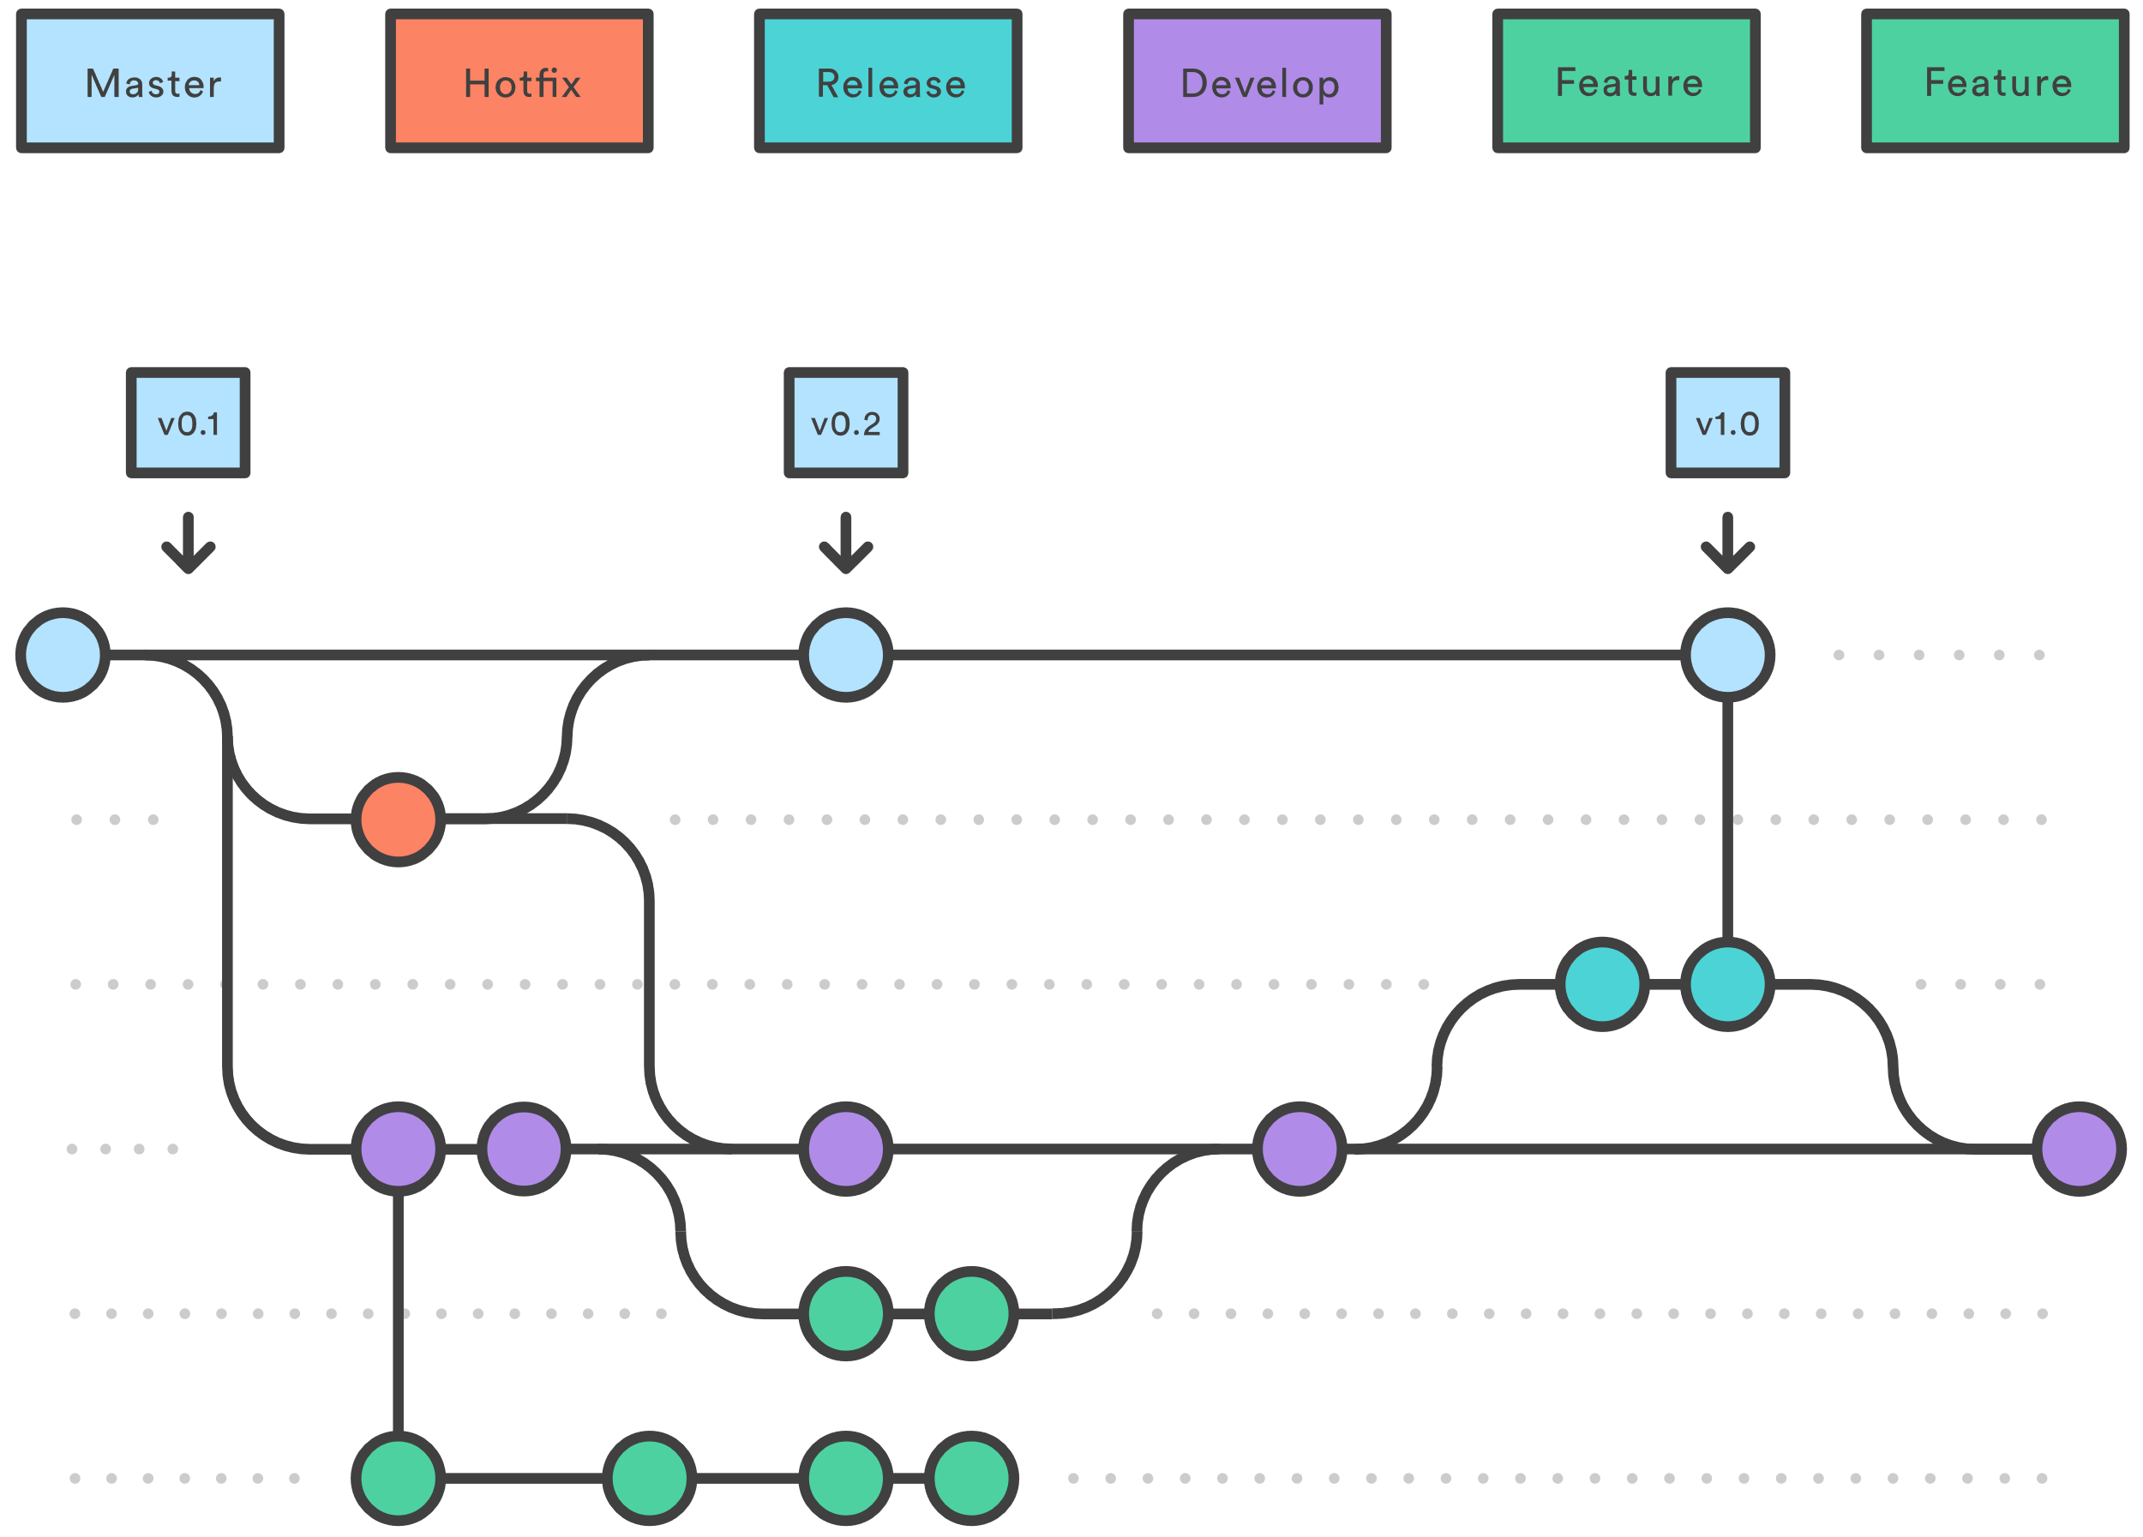
Standardize your Workflow
GitFlow

Slide 15
Standardize your Workflow
Set a common version numbering system
Chocolatey and Nuget package versioning: SemVer.
The good, the bad and the ugly about SemVer.
A solutions the YMX.

Slide 16
Standardize your Workflow
Chocolatey and Nuget package versioning.
All version Chocolatey and Nuget support SemVer 1.0 :
A specific version number is in the form Major.Minor.Patch[-Suffix], where the components have the following meanings:
Major: Breaking changes
Minor: New features, but backwards compatible
Patch: Backwards compatible bug fixes only
-Suffix (optional): a hyphen followed by a string denoting a pre-release version.
Examples:
1.0.1
6.11.1231
4.3.1-rc
2.2.44-beta
11.0.1-alpha
All version Chocolatey and Nuget also support Microsoft Version Numbers:
A specific version number has the a 4 number form: Major.Minor.Buid.Revision
Chocolatey call this form : Package Fix version Notation
Examples: 1.2.0.20181008

Slide 17
Standardize your Workflow
The good, the bad and the ugly about SemVer.
The good:
Has release and pre-release version
Tell you if you need to update:
MAJOR: Breaking API change
Not safe to update
MINOR: New features
Safe to update
PATCH: Bugfixes
Must update

Slide 18
Standardize your Workflow
The good, the bad and the ugly about SemVer.
The bad:
With rapid space of CD is difficult to follow MAJOR, MINOR and PATCH ordering.
It's assumes that every goes well and arrive on time.
It's only great once the product is done and tested.

Slide 19
Standardize your Workflow
The good, the bad and the ugly about SemVer.
The ugly:
Difficult to automate.
Need a lots manual intervention.
With things like versioning of things API, the MAJOR and MINOR doesn't mean anything for artifacts version.
You can always put the major version in the product name. Ex: X11, Oracle12c and C

Slide 20
RELEASE CANDIDATE Version for release/ and hotfixe/ branch:
YY.M.N-rcX
Standardize your workflow
A solution the YMX.
Inspired on Docker’s versioning scheme
RELEASE version for master branch: YY.M.N
18.1.9
RELEASE CANDIDATE Version for release/ and hotfixe/ branch: YY.M.N-rcX
18.1.9-rc 18.3.2-rc4
ALPHA Version for feature/ branch: YY.M.N-alpha-DD-hhhhhhh
18.3.3-alpha-08-df81230 for the commit done the Mars 8th 2018 in preparation for third release in Mars 2018

Slide 21
Standardize your Workflow
Clean up and Enforce
Clean up all your repositories.
By doing a clean-up, it is the right time to introduce new tools and processes.
Train your team to use new tools and teach them how to apply your workflow and demonstrate why.
Enforce workflow progressively by applying it, with a small group of team members and target applications.

Slide 22
Jenkins 2
Pipeline as a code.
Create your own Shared Libraries.
YMX automatic versioning.
<Live demo>

Slide 23
Jenkins 2
Pipeline as a code.
Pipeline as Code describes a set of features that allow Jenkins users to define pipelined job processes with code, stored and versioned in a source repository. These features allow Jenkins to discover, manage, and run jobs for multiple source repositories and branches — eliminating the need for manual job creation and management.
To use Pipeline as Code, projects must contain a file named Jenkinsfile in the repository root, which contains a "Pipeline script."

Slide 24
Jenkins 2
Create your own Shared Libraries.
As Pipeline is adopted for more and more projects in an organization, common patterns are likely to emerge. Oftentimes it is useful to share parts of Pipelines between various projects to reduce redundancies and keep code "DRY".
Pipeline has support for creating "Shared Libraries" which can be defined in external source control repositories and loaded into existing Pipelines

Slide 25
Jenkins 2
Create your own Shared Libraries.
Declarative Pipeline
Scripted Pipeline
Directory structure
The directory structure of a Shared Library repository is as follows:
(root) +- src # Groovy source files | +- org | +- foo | +- Bar.groovy # for org.foo.Bar class +- vars | +- foo.groovy # for global 'foo' variable | +- foo.txt # help for 'foo' variable | +- bar.groovy # bar custom step, call def call() +- resources # resource files (external libraries only) | +- org | +- foo | +- bar.json # static helper data for org.foo.Bar

Slide 26
Jenkins 2
<Live demo>

Slide 27
Sonatype Nexus
Nexus introduction.
Consideration for Chocolatey.
<Live demo>

Slide 28
Sonatype Nexus
Nexus Reposory Manager introduction
Universal package manager
That give us the ability to apply security and compliance metrics across all artifact types. Universal package managers have been referred to as being at the center of a DevOps toolchain
Nexus Repository OSS 3.xx, supports those formats:
APT, Composer, Conan, CPAN, Docker, ELPA, Git LFS, Helm, Maven, npm, NuGet, P2, PyPI, R, Raw, RubyGems, Yum

Slide 29
Sonatype Nexus
Consideration for Chocolatey.
Don’t mix Nuget package with Chocolatey package. Even if Chocolatey is based on the NuGet framework, it doesn’t mean that they are the same type of package.
Separated in different repositories, depending on the target. Users workstations, developer workstations, agents workstations, servers. You can also create separate repositories for certain products.

Slide 30
Sonatype Nexus
<Live demo>

Slide 31
SaltStack
Introducing SaltStack
Salt architecture
Execute remote or local command
Salt and Chocolatey.
Defining the desired States
Jinja2 and Pillars
Live demo.

Slide 32
SaltStack
Introducing SaltStack
Open-source configuration management software and remote execution engine.
Infrastructure as code
Python based
Use asynchronous messaging queue
Fast and scalable
Mainly referred as “Salt”

Slide 33
SaltStack
Salt architecture
Designed for high speed data collection and execution in system administration environments. At beginning Salt was relying on ZeroMQ. Salt now has is own realiable queuing transport system: RAET (Reliable Asynchronous Event Transport Protocol). Which permit Salt to be scalable well beyond tens of thousands of servers.

Slide 34
SaltStack
Salt architecture
Salt mainly use a slave-master setup, that enables Salt to do push or pull remote execution. The slave or the agent is called : Minion.
Minion can be also be used alone in a MasterLess mode.
Salt has also AgentLess mode called: Salt-SSH. Salt has no Windows AgentLess mode yet.

Slide 35
SaltStack
Salt architecture
Salt mainly use a slave-master setup, that enables Salt to do push or pull execution. The slave or the agent is called : Minion.
Minion can be also be used alone in a MasterLess mode.
Salt has also AgentLess mode called: Salt-SSH. Salt has no Windows AgentLess mode yet.
Salt permit also event-driven execution and self-healing.

Slide 36
SaltStack
Salt architecture
The modular design of Salt is done by module written in Python. By the abilities to write your own Salt Module, Salt is easily extensible.
Module types:
Execution modules
State modules
Grains
Renderer modules
Returners
Runners

Slide 37
SaltStack
Execute remote command
salt-call '*' test.ping
salt-call '*' disk.usage
salt-call -G 'os:Windows' cmd.run ‘dir‘
salt-call –local cmd.powershell “Get-ChildItem c:\”

Slide 38
SaltStack
Saltstack and chocolatey
salt-call --local chocolatey.bootstrap
salt-call --local chocolatey.update firefox

Slide 39
SaltStack
Defining the desired States
firefox.sls : chocolatey: pkg.installed firefox: chocolatey.upgraded: - pkgs: - firefox
salt-call state.apply firefox

Slide 40
SaltStack
Jinja2 and Pillars
Using grains in SLS
Pillars
apache: {% if grains['os'] == 'RedHat' %}
pkg.installed: - name: httpd {% elif grains['os'] == 'Ubuntu' %}
pkg.installed: - name: apache2
{% if grains['os'] == ‘Windows' %}
chocolatey.installed:
- name: apache-httpd
{% endif %}

Slide 41
SaltStack
<Live demo>

Slide 42
Choclatey hacks
Multiple instances of Chocolatey.
Mock a package install.
Workstations
Internalize your Chocolatey packages.
Onboarding developers workstation.
Life without Citrix.

Slide 43
What we've Learned
Patience. Renovating a house will always take more resources than building a new one. But the importance is to always be evolving.
Impose standardization of your process. Less experienced team members will often have a certain lack of discipline. But some older team members are more resistant to change their discipline.
Make the jobs fun. Try to replace boring tasks by automated process or try to reduce time past on those boring tasks.

Slide 44
What we learn
Try to avoid everything that is not human readable like .MSI, .XML and Windows registry.
Click, click alone is really very bad. If you can write a how-to wiki. You can write a script (preferably with a CM). If you have a good script, you can do a one-liner command. With that you can easily create a WebUI or GUI for a secure self-service.
Concentrate on useful metrics and make only useful alerts.
Innovate and don't be afraid to push the envelope

Slide 45
Thanks
A special thanks to my team at TD.
To Rob Reynolds, to make me love Windows again.
Chocolatey Fest team…

Slide 46
Q&A

